Slide 1
Writing a Publishable Journal Article
Example #1:
The effect of Taiwan’s protection mechanisms on innovation activities
臺灣廠商保護型態對創新活動之影響
Example #2:
Monetary Policy and Long-Term Real Rates

Slide 2
Writing Tips for Ph. D. Students
John H. Cochrane
Graduate School of Business University of Chicago
http://gsbwww.uchicago.edu/fac/john.cochrane/research/Papers/

Slide 3
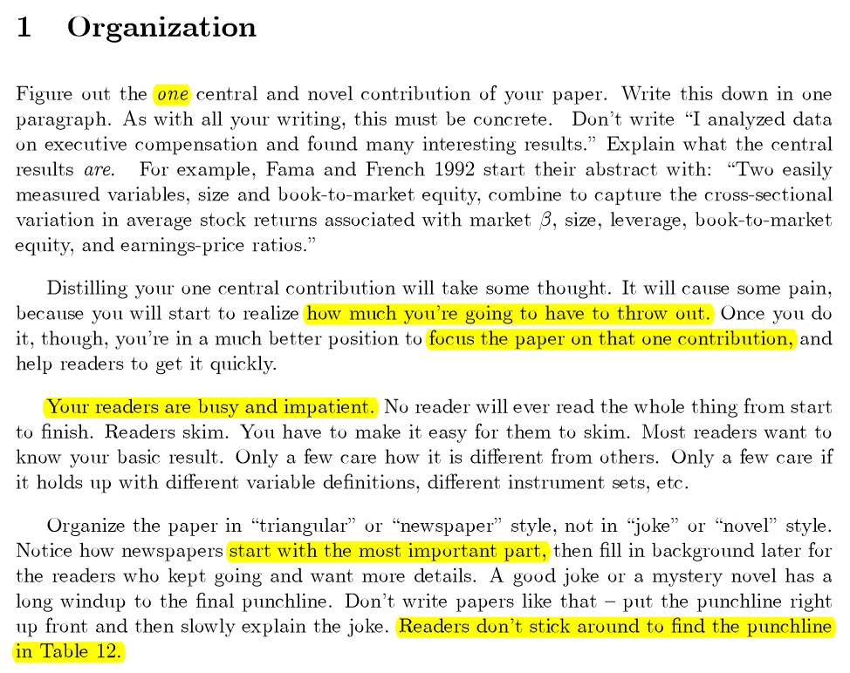

Slide 4
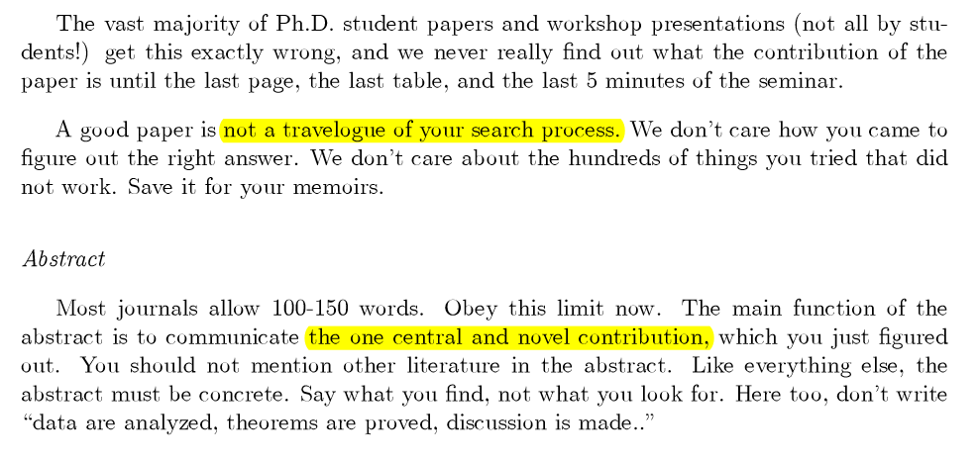

Slide 5
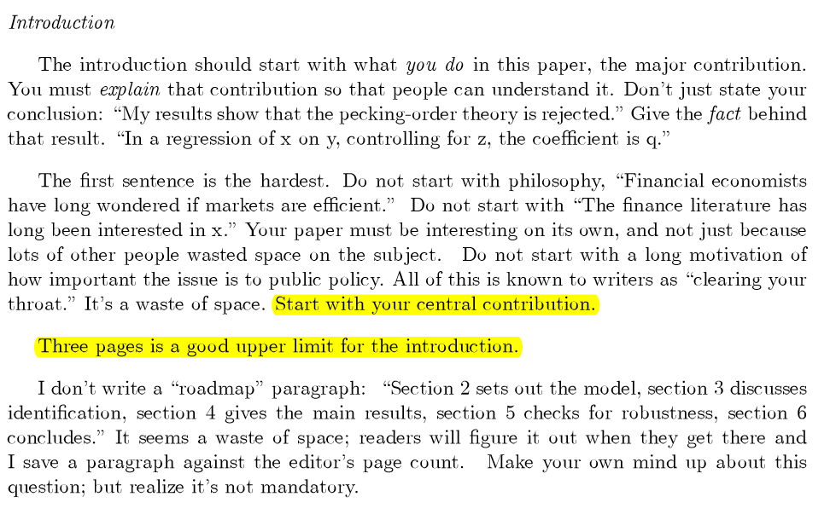

Slide 6
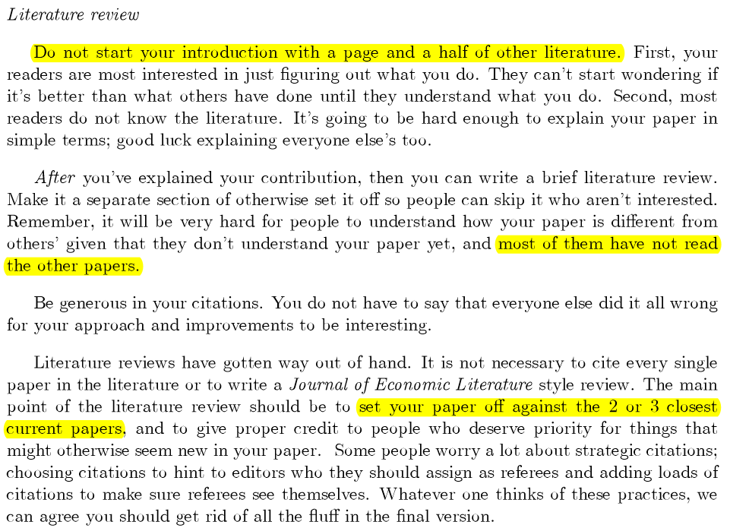

Slide 7
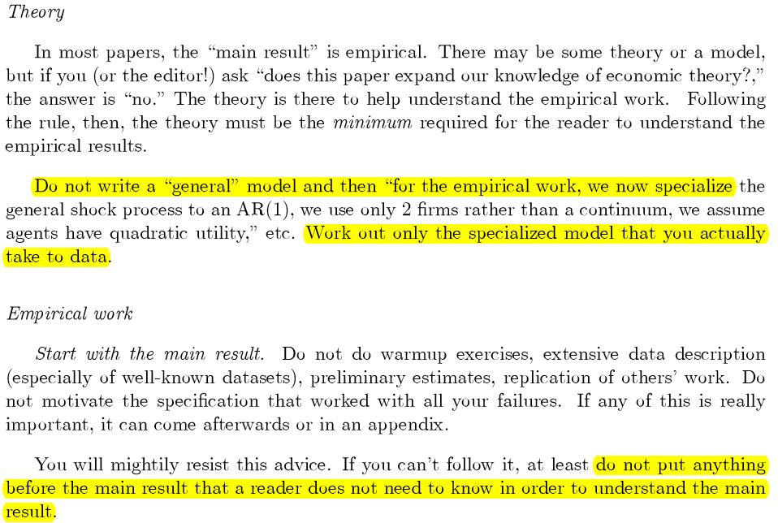

Slide 8
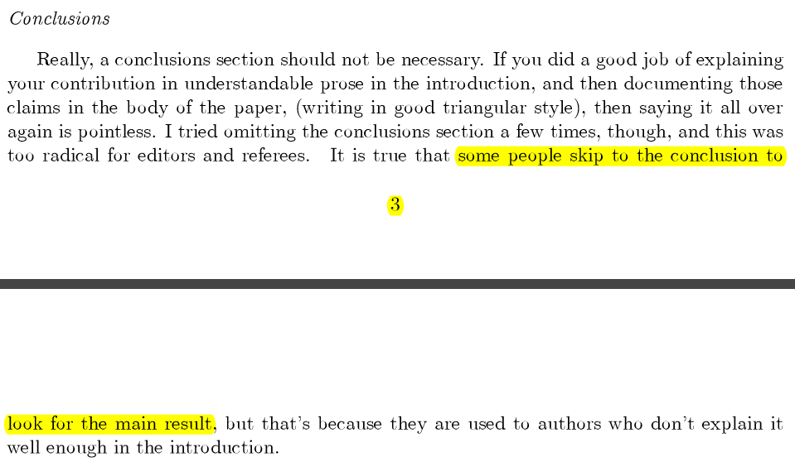

Slide 9
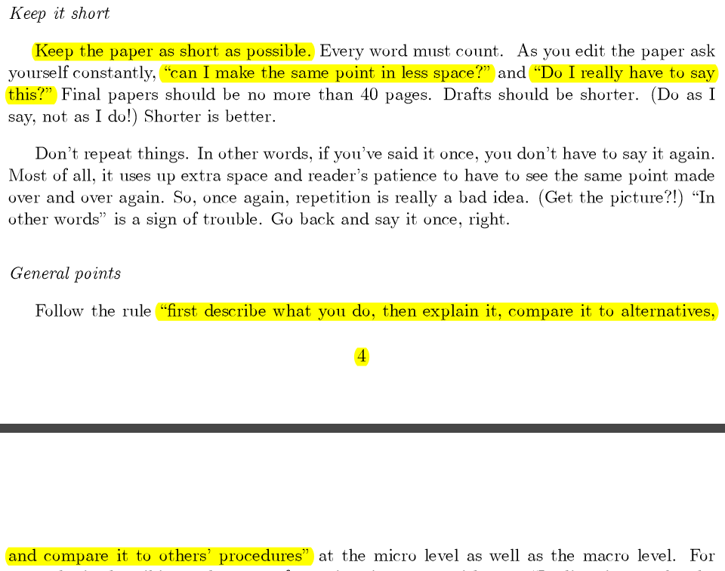

Slide 10
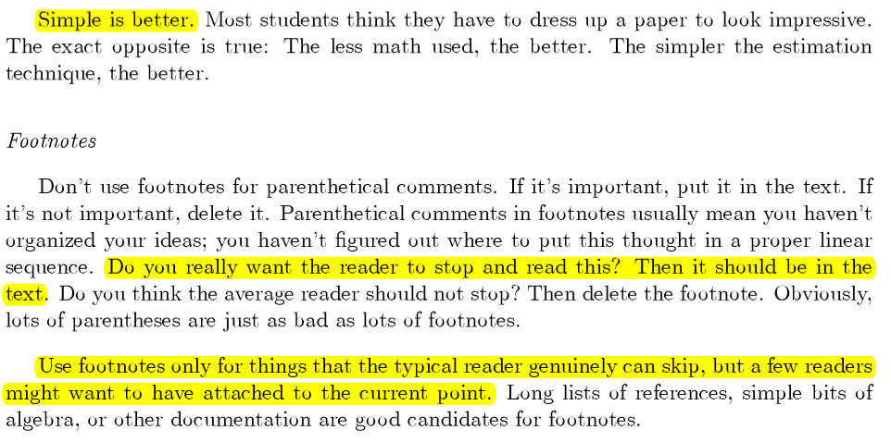

Slide 11
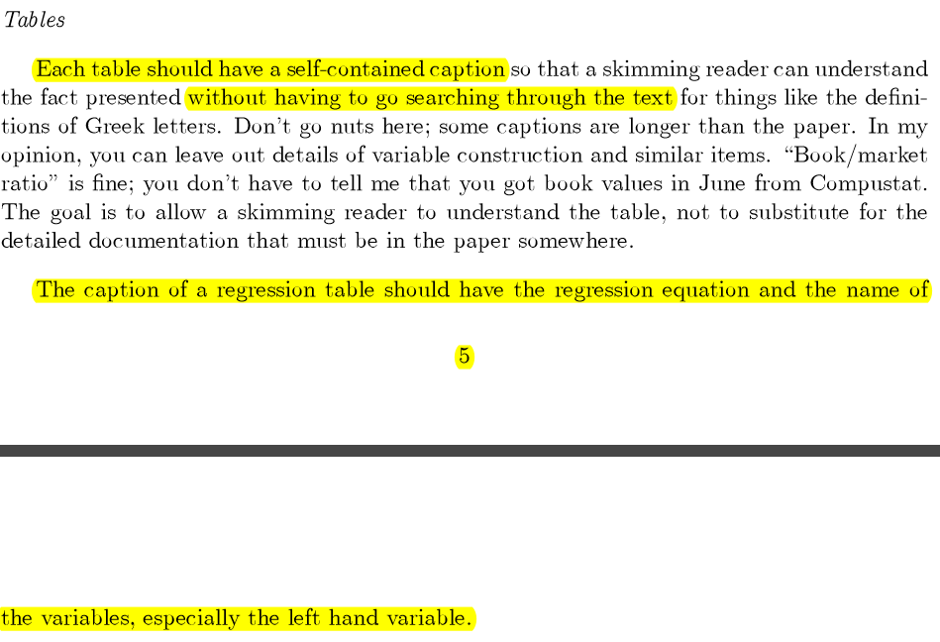

Slide 12
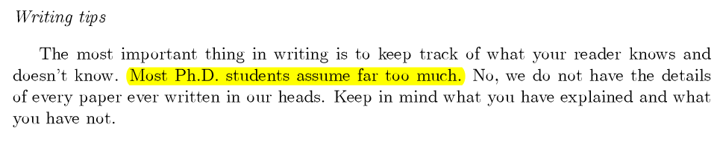
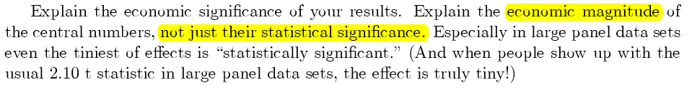

Slide 13
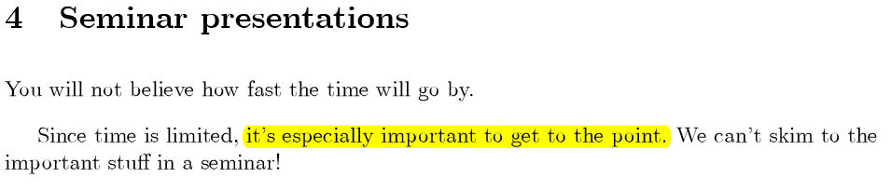
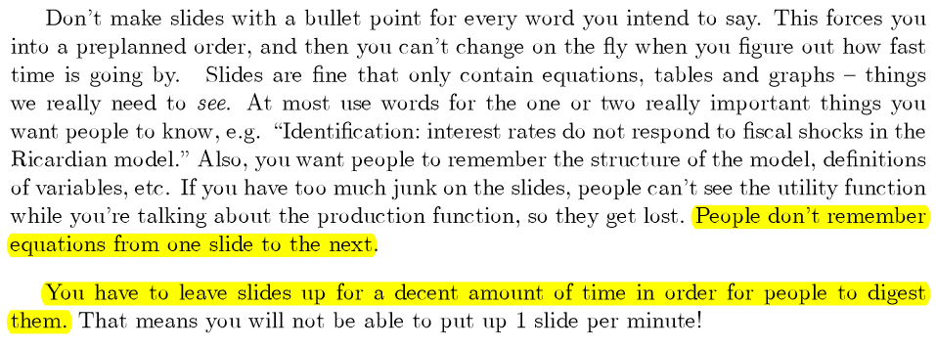

Slide 14
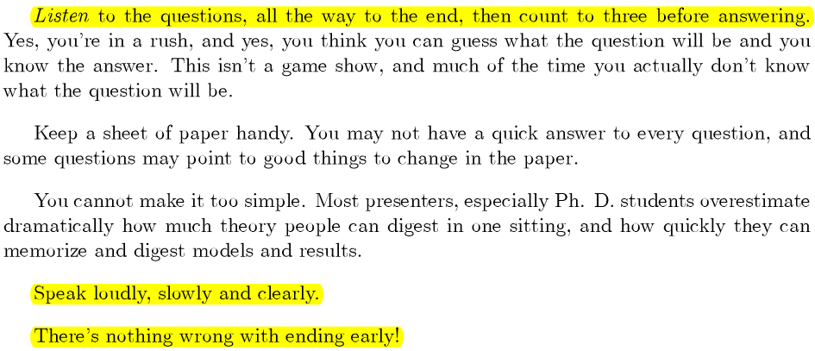

Slide 15
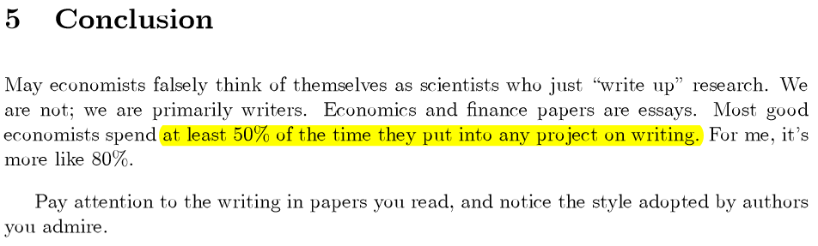

Slide 16
Example: Paper Writing Workshop: ECON6990
First Stage: Write a referee report for a paper which your project will be based on.
Find a paper of your interest from the working paper series of the Federal Reserve Banks from 2005 to date (if the paper is published, use the published version). Write a referee report, which should include a summary of the paper and the contribution it makes. At the end of the report explain how you will build your project on it.

Slide 17
Second stage: Write a one-page proposal of your project. The one-page proposal should answer three questions:
(1) What are you doing?
Be specific, no more than two sentences
(2) Why are you doing it?
This is the key. You MUST use a theory and/or previous literature to explain your motivation.
To check whether your answer is legit, specify your null hypothesis. Before running any empirical work, can you explain your result no matter whether you reject or fail to reject the null hypothesis? If you cannot, you did not answer the question.
(3) How are you doing it?
Make sure you have the data and understand the methodology.

Slide 18
Third stage: Write a 5-page proposal of your project.
The 5-page proposal should specify the motivation, empirical model, estimation method, main hypothesis, and data source.
This is basically an extension of the second stage.

Slide 19
Fourth stage: The final proposal of your project.
It should include:
The motivations and a clear description of the theories or literatures that support the motivations;
The empirical model and estimation method;
Main hypothesis;
Sample statistics of your data and plots of the main variables;
Preliminary results and a brief discussion of the results.

Slide 20
Fifth stage: the first draft of the project
Special attention is paid to the professional writing style (correct spelling and grammar, clear exposition, and good organization). The draft should at least include the following sections:
A title page that includes an abstract;
Introduction;
Model and data descriptions;
Empirical results;
Conclusions;
References.

Slide 21
The next steps if you want to make this project your job market paper:
Revise the draft based on the comments you receive from this workshop. Submit it to a conference.
➔
Present your paper in the faculty workshop.
➔
Revise. It is your job market paper.
➔
Present your paper in a conference.
➔ Go to AEA annual conference.

Slide 22
SUGGESTIVE GUIDELINES
(courtesy of Professor Art Goldberger and Professor Ken West)
In writing the papers, special attention should be paid to style (correct spelling and grammar, clear exposition, good organization). Papers that are difficult to read routinely get rejected by referees and editors of economics journals, even if they contain a good idea. Thus it will pay to develop the habit of working hard to craft a clear explanation of your research.
Many of the following suggestions are standard good practice. Others are matters of taste.

Slide 23
SUGGESTIVE GUIDELINES
(courtesy of Professor Art Goldberger and Professor Ken West)
1. In writing up a research report, one should have an audience in mind. I suggest that you take the audience to be your fellow students in this course. They will know most of the relevant economic and econometric theory, but will not know your data set or your model.
2. Include a cover page with the following information: Title; date; your name; your office address and office phone number; your e-mail address; the word “Abstract”; an abstract of 100 words or fewer. The text of the paper begins on the next page.
3. Your paper should be divided into sections, to help guide the reader. Recall the basic structure of a typical paper is: introduction, which presents an overview and summarizes; specification of the model; presentation of results; discussion; conclusion, which includes suggestions for future research. You may not have exactly these five sections. For example, you may have an additional section that reviews the literature. Or you may combine presentation of results and discussion into a single section.

Slide 24
SUGGESTIVE GUIDELINES
(courtesy of Professor Art Goldberger and Professor Ken West)
4. Be explicit about your data set. State the sample size. For time series, state whether the data are monthly, quarterly or annual, and whether or not they are seasonally adjusted. State the units of measurement. For example, if “income” is a variable, state whether it is measured in current dollars or constant 1992 dollars, and if it is per capita, say so. For data in logs or log differences, you will usually want to multiply by 100 so that the units will be percent or percent change. Also explain the choice of the sample: why does it start in a given year, or you use only a cross-section from a given year instead of a panel, and so on.
5. You will usually want to include a plot and/or a table with basic statistics (means, standard deviations) of the data.
6. Number the pages.

Slide 25
SUGGESTIVE GUIDELINES
(courtesy of Professor Art Goldberger and Professor Ken West)
7. Number the equations. You can number the equations by section, if you have sections in the paper. That is, the third equation in section 2 can be numbered 2.3, the second equation in section 4 can be numbered 4.2, etc., if you prefer doing this to numbering sequentially through the paper.
8. Avoid the use of elaborate acronyms to denote variables (like AUSGDP_90 for Australian GDP in 1990 dollars). They are rarely helpful to the reader. A single letter, usually with a subscript, ordinarily suffices and is easier to read when used in equations.
9. Do not begin a sentence with a symbol or number.
10. An equation is not a sentence by itself. “Where x = income, y = consumption” is also not a sentence by itself. See (almost) any text or journal article for examples of proper treatment of such material.

Slide 26
SUGGESTIVE GUIDELINES
(courtesy of Professor Art Goldberger and Professor Ken West)
11. Don’t confuse statistical significance with economic (or sociological, or financial) importance.
12. Hypotheses refer to the magnitudes of population parameters, not estimates, and certainly not to statistical significance. The word “significant” should never appear in the statement of a hypothesis. Estimates (not parameters) may be “significant” or “insignificant”. Hypotheses (not tests) may be “accepted” or “rejected”.
13. It is a bad idea to say that the significance level of a test is 95% when it is actually 5%.

Slide 27
SUGGESTIVE GUIDELINES
(courtesy of Professor Art Goldberger and Professor Ken West)
14. Tables:
a. Number the tables, and on each include a descriptive header (“Means and Standard Deviations of Data,” or “Variance Decompositions,” for example).
b. Tables may appear in the text in the appropriate place, or at the end of the paper.
c. Make every effort to make each table self-contained, even though this will require you to redundantly present information that is also stated in the body of the paper itself.
d. In notes at the bottom of each table, define the symbols that are in the table, or give a precise reference to where the definition may be found. It is not adequate to simply state “definitions are in the paper” or “see section 2 of the paper for definitions”. Instead say something like “Variable definitions: y: log per capita income in 1992 dollars, r: interest rate on 3 month Treasury bills (end of quarter),” and so on. Alternatively, for many of you it might be best to include a table that defines the symbols, and in subsequent tables say “see Table x for variable definitions” where “x” is the number of the table that defines the symbols. (You will also present such information in the text itself.)

Slide 28
SUGGESTIVE GUIDELINES
(courtesy of Professor Art Goldberger and Professor Ken West)
Tables:
In tables that present regression results, include a note that describes the estimation technique (“The probit was estimated by maximum likelihood, assuming normality,” for example.) (You will also present such information in the text itself.)
In all but the simplest tables, number the rows and columns. When the text references a result in the table, cite the row and column: “the t-statistic is 2.12 [row (2), column (4)].”

Slide 29
SUGGESTIVE GUIDELINES
(courtesy of Professor Art Goldberger and Professor Ken West)
Figures:
a. Number the figures, and on each include a descriptive header (“Parental Income versus SAT Score,” for example).
b. Figures may appear in the text in the appropriate place, or at the end of the paper.
c. Figures should not run over page boundaries, and must always fit on a single page. That is, if you include a figure in the text, you should insure that you place it so that it does not run from one page to the next.

Slide 30
SUGGESTIVE GUIDELINES
(courtesy of Professor Art Goldberger and Professor Ken West)
16. Reporting of estimates:
a. Do not report more than 3 or 4 digits. Example: report 0.412, not 0.4117678.
b. Avoid long strings of zeroes at the beginning of a number. You can always retroactively rescale variables and coefficients.
c. Report standard errors, not t-statistics. Standard errors belong in parentheses under the coefficients. Example: Report
0.412
(0.146)
not
0.412 0.146
d. Papers that use bootstrap techniques often report confidence intervals instead of standard errors. An analogous style should be used:
0.412 (0.196,0.499)

Slide 31
SUGGESTIVE GUIDELINES
(courtesy of Professor Art Goldberger and Professor Ken West)
17. Reference:
a. All references cited in the paper should be listed in a bibliography at the end of the paper. Cite these in the text as Walter (1995) or Walter (1995, p361).
b. When you reference a specific result, such as a point estimate of a parameter, or a theorem that establishes a particular claim, give the page number, such as Walter (1995, p361). When you reference a general result, for example noting other papers that have studied topics similar to yours, no page number is needed.
18. Your own paper should be self-contained (even though I ask you to turn in a copy of the published paper). As well, you need to be crystal clear about what you have done versus what is in the published paper. If you obtain your data from the authors of the published paper, for example, you must explicitly say so, even though you will also need to describe the source used by the authors of that paper.

Slide 32
SUGGESTIVE GUIDELINES
(courtesy of Professor Art Goldberger and Professor Ken West)
19. It is a violation of scholarly ethics to repeat a passage, even a sentence, from another paper without putting the passage in quotes and citing the exact page number. This rule applies even when you are describing dreary facts: if you repeat a description from another paper of how data were collected, or the steps in computing an estimate, you must put the passage in quotation marks and cite the original source.

